Slide 1
Demo Day
Acute Malnutrition Prevention Lab
India 2019

Slide 2
Welcome
Brenton Caffin
Executive Director, Global Innovation Partnerships

Slide 3
Hemang Shah & Biva Rajbhandari
Childrens Investment Fund Foundation

Slide 4
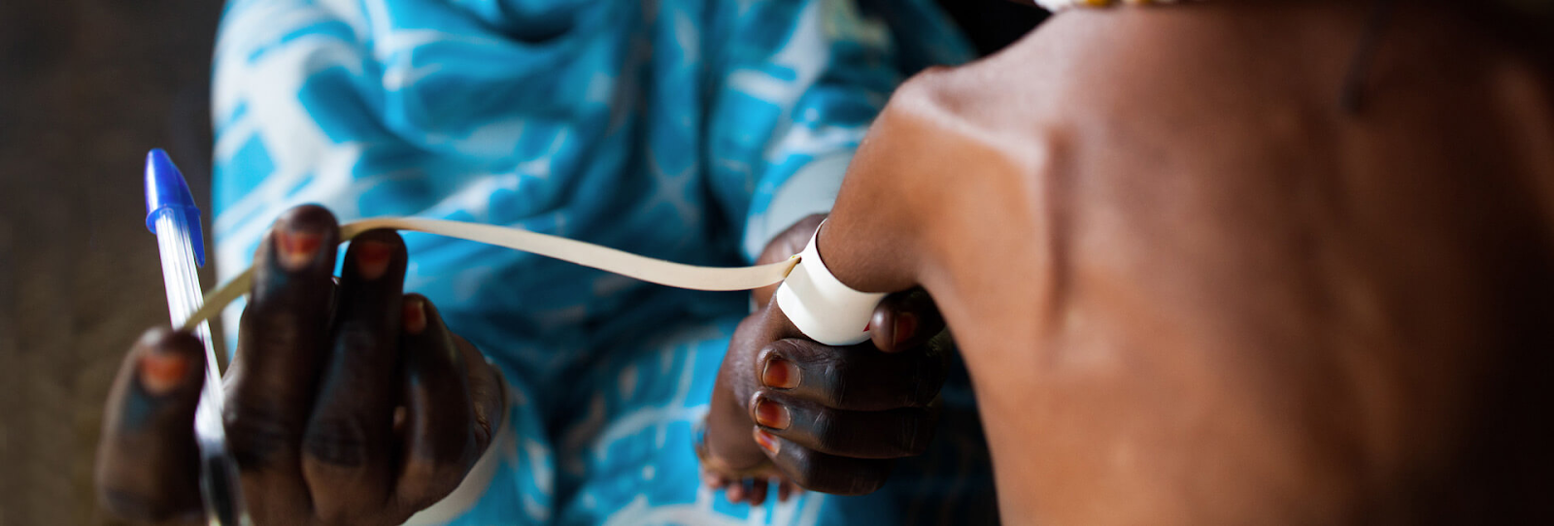
Why the Lab
Kate Sutton
NESTA

Slide 5
Traditional Approach
Lab Approach
Mapping community ‘needs’ (e.g, identifying what is missing/deficient and then offering a service to fill the gap)
Narrow/targeted project intervention
Linear solutions (problems are tackled directly)
Assume beneficiaries/targets behave like ‘rational actors’ (acting in their best interests)
Learning happens through evaluation at conclusion of grant/project
Works incrementally to improve the situation
Mapping community assets (e.g, assessing the resources, skills, and experience that already exist to solve the problem and building on those)
Systems thinking and ecosystem investment
Oblique solutions (problems can be tackled holistically and indirectly)
More nuanced understanding of human behaviour, based on behavioural science insights
Fast feedback loops and lean processes, plus adaptive management accelerate weeding out of ineffective ideas and quick validation of those with promise
Tries to find ways to exponentially scale the best solutions.

Slide 6
Surbhi Pandit &
Dr. Aditya Dev Sood
Vihara Innovation Network

Slide 7
Suhit Anantula
NESTA

Slide 8
The Malnutrition Challenge
Notes:
Urban
No clear ways to solve it globally
It’s not just about food
May be some of them are having 3 meals a day
Money to buy snacks
Nutrition is in inefficient

Slide 9
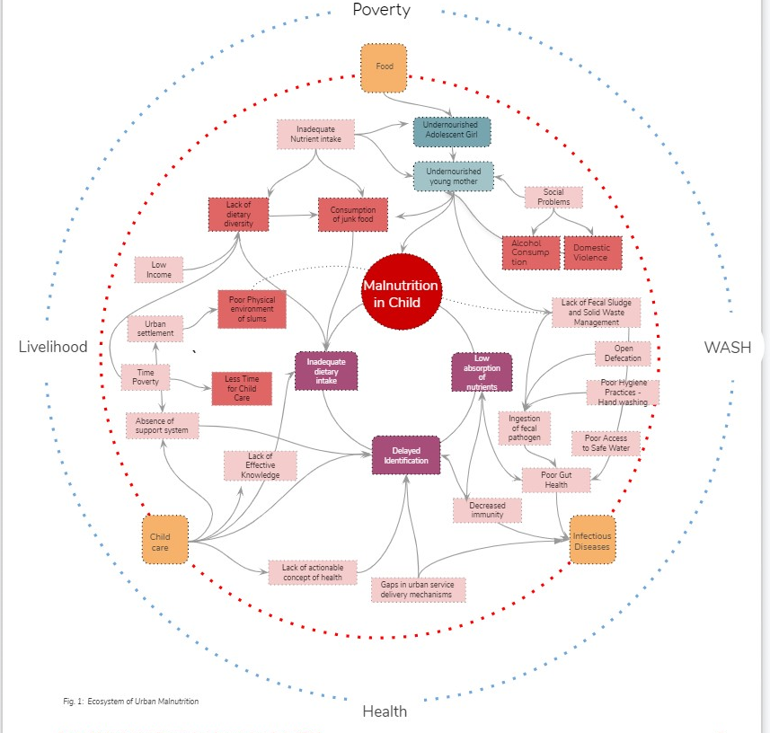
The Ecosystem of Malnutrition
Seeing the problem as a system and solving it as a system

Slide 10
It’s being Baby Ready!
We present the
“Baby Ready Family Coalition”

Slide 11
A Coalition –
system level,
multi stakeholder,
coordinated and
targeted

Slide 12
Part of the current system
Work with Government and current programs

Slide 13
Audience
Individual
Adolescents (M/F)
Recently Married (M/F)
1000 days (M/C)
Families
Community

Slide 14
Who is this coalition

Slide 15
Redefining Nutrition
Changemakers
Data Driven Decision Making

Slide 16
Pitch

Slide 17
Redefining Nutrition
Changemakers
Data Driven Decision Making

Slide 18
Redefining Nutrition

Slide 19
Rani
14 years old, lives next to an open drain in VP Singh Camp, New Delhi
Likes to eat outside, loves fruits
Both parents working
Can’t afford fresh vegetables, eats one cooked meal a day
Deficient in iron, low BMI

Slide 20
What is the problem?
Accessibility
Affordability
Uptake
Capacity to Assess

Slide 21
Why does the problem continue to persist?
Treatment over prevention
Unaccounted preferences
One solution for all
Unsustainable models
Limited food spectrum

Slide 22
Process-based solution – 10X
Expanding the food spectrum
Reframing the approach to nutrition
Redefining nutritious food

Slide 23
Process-based solution – 10X
Expanding the food spectrum

Slide 24
Process-based solution – 10X
Reframing the approach to nutrition
Include adolescents and recently married persons
Incorporate individual and community preferences
Adopt context-specific programmes
Use sustainable models
Ensure collective concern

Slide 25
Process-based solution – 10X
Redefining nutritious food
Safe and hygienic
Nutrition-dense
Locally-sourced ingredients
Fresh produce
Based on individual and community preferences

Slide 26
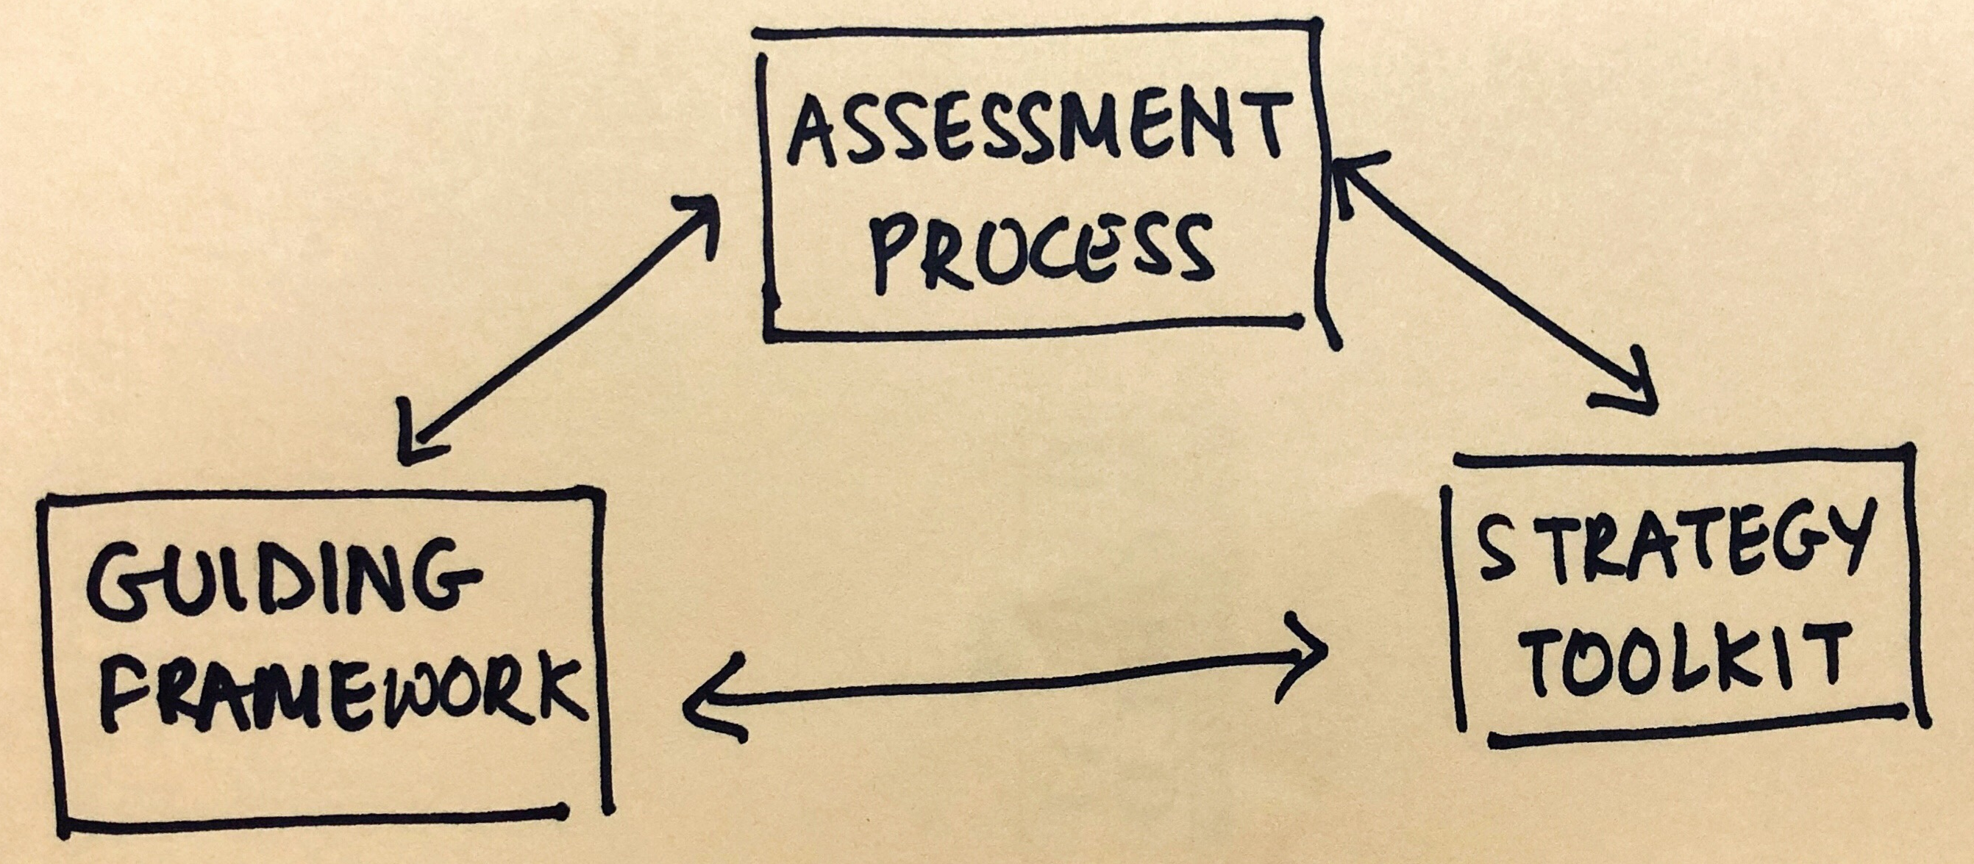
The Gameplan

Slide 27
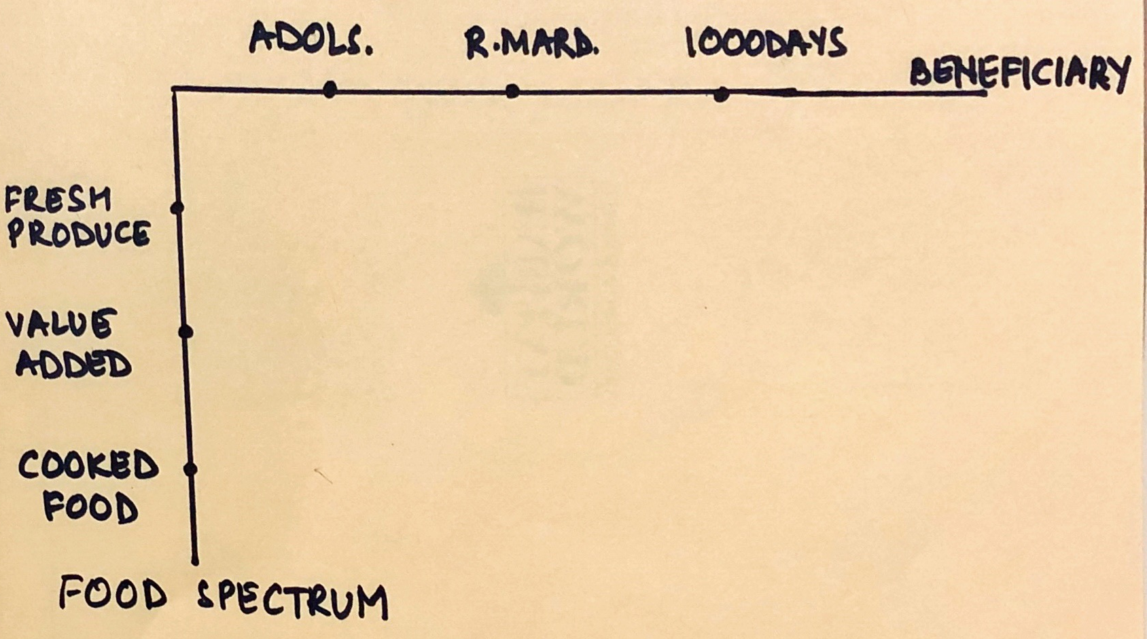
The Gameplan
Assessment Process
Community FoodPrint
Tangible and Intangible Preferences
Nutrition Requirements
Wellbeing (Health & WASH) Indicators

Slide 28
The Gameplan
Guiding Framework
Combine on-the-ground data with technical expertise
Use assessment process to identify community needs
Adapt relevant and actionable strategies from the toolkit

Slide 29
The Gameplan
Strategy Toolkit
Fresh Food Webs
Supplementary Food Webs
Cooked Meal Food Webs
*Nutrition Food Web* - A network of producers, processors, sellers, role models, consumers etc based on market and non-market based sustainable models.

Slide 30
Outputs
Improve affordability and accessibility of nutritious food
Improve uptake of nutritious food
Increase capacity to assess nutrition requirements
Through
Livelihoods in the nutrition space
Collaborating with existing stakeholders
Sustainable models
Collective responsibility

Slide 31
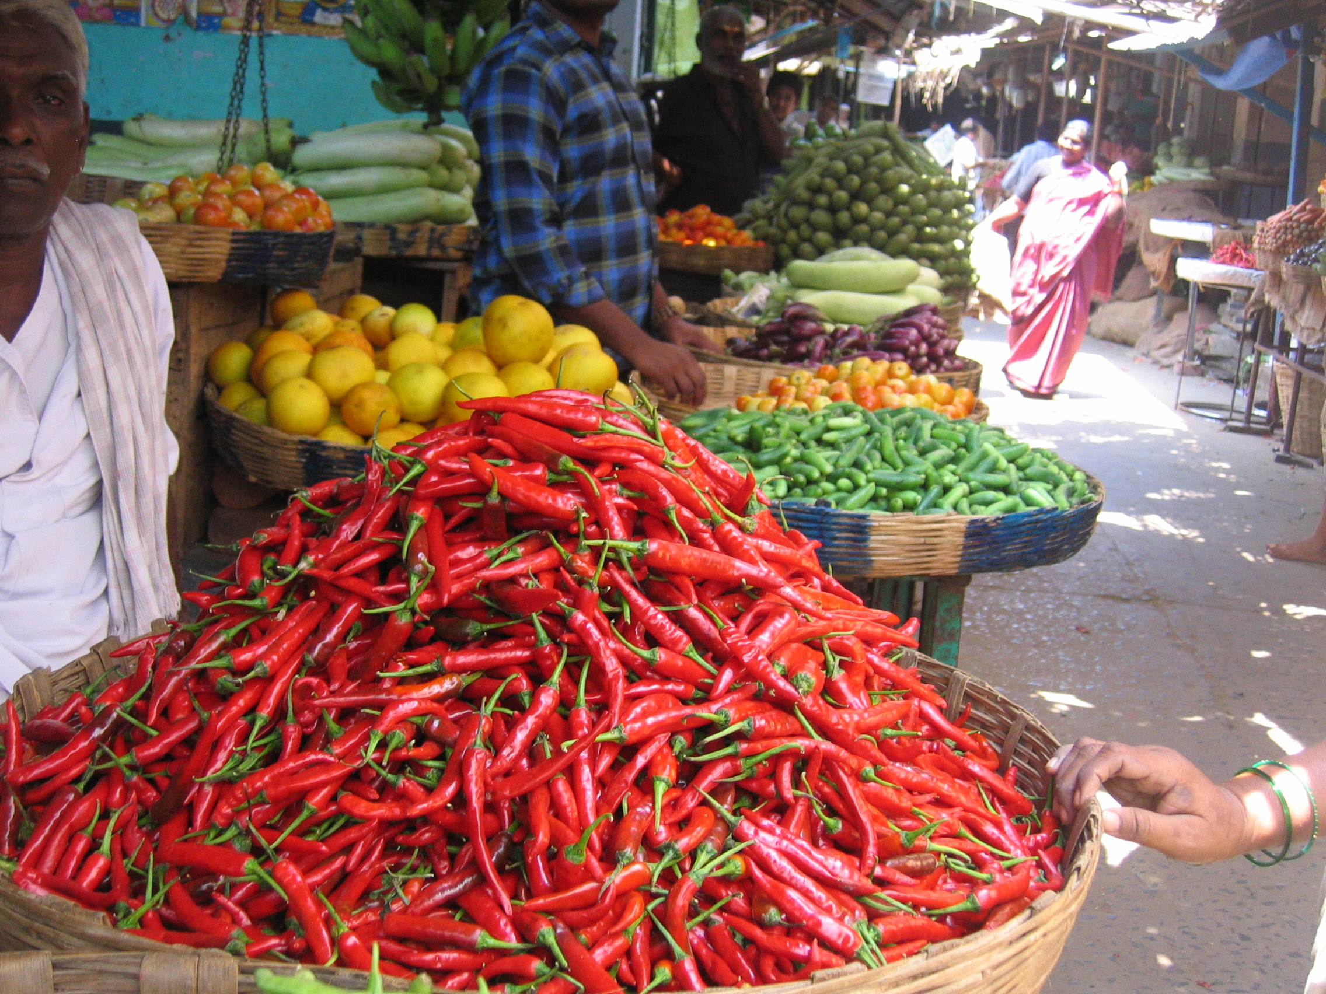
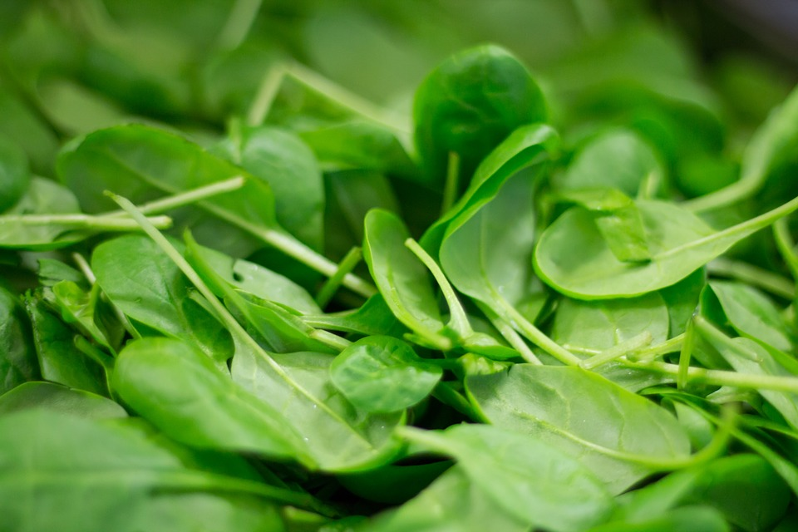
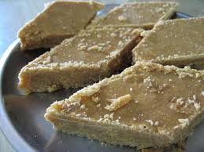
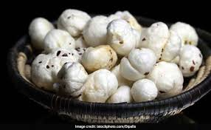
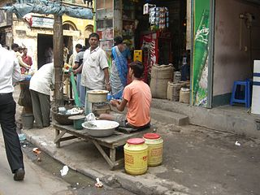
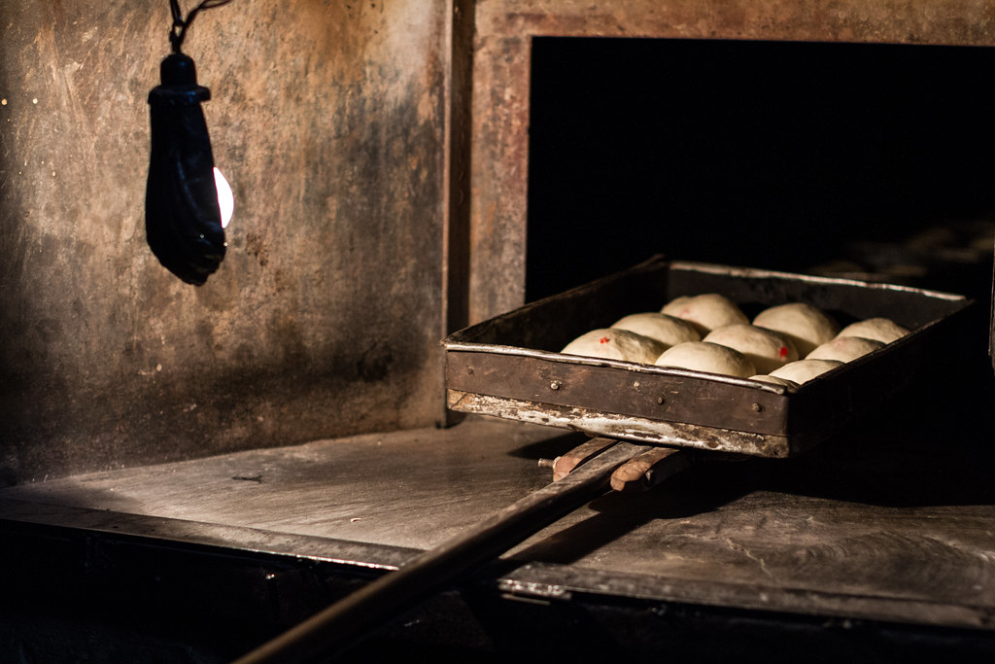
What does this look like?

Slide 32
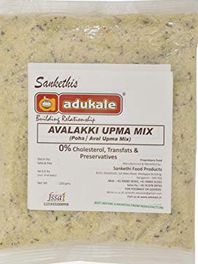
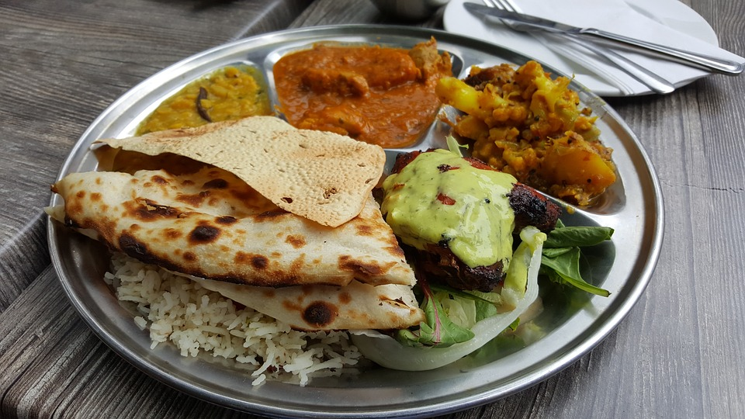
What does this look like?
Use small open spaces in VP Singh Camp to grow micro-greens
Make fortified nutritious snacks available at the local grocery store
Window kitchens for freshly cooked food so Rani can eat hot meals even when her parents are away

Slide 33
Partners
Swami Sivananda Memorial Institute

Slide 34
Any Questions?

Slide 35
Redefining Nutrition
Changemakers
Data Driven Decision Making

Slide 41
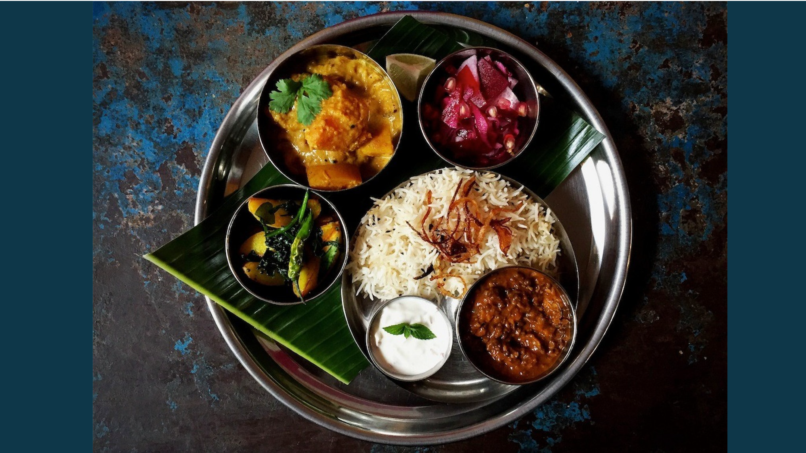

Slide 48
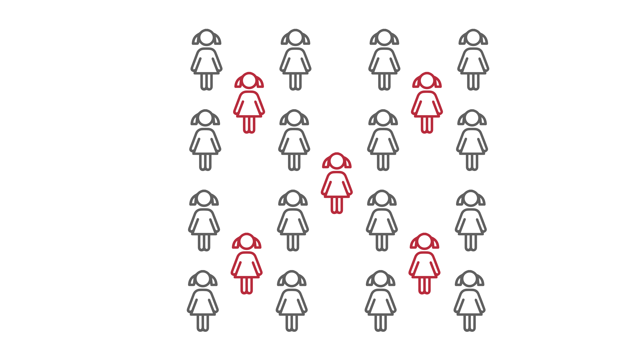

Slide 50
Any Questions?

Slide 51
Redefining Nutrition
Changemakers
Data Driven Decision Making

Slide 52
Data Driven Decision Team

Slide 53
Background
Inaccessible
Scattered
Not Public
DATA
Insufficient
Unverified
Outdated
No Integrity
In Silos
The problem gets compounded when tackling critical subjects such as malnutrition where accurate, real-time, intervention is absolutely necessary!

Slide 54
Setting the Scene
- Rani is not aware about the right nutrition, health & sanitation
- The family doesn’t know if the growth of the baby is on track
- The Community is unaware about their current nutrition, health, wash status
- The donor is not aware of where the gaps are and the real time impact/progress
- The policy maker don’t have enough actionable data for policy intervention

Slide 55
You can only manage what you can measure!
End-to-End Data Driven Solution
Baseline Data collection and GIS mapping
Single app for all stakeholders
Monitoring of community activities + impact assessment
Policy Dashboard:
Targeted policy intervention
Monitoring nutrition and W.A.S.H metrics + intervention points
Donor Dashboard:
Real-time data for targeted funding
Agile, Replicable and Scalable.
Notes:
Foodprint

Slide 56
Model
Nutrition Team
Policy
Data driven intervention
Tracking foodprint
Tracking nutrition uptake
Donor
Community
Family
Changemaker Team
Data Team
GIS mapping
Data collection app
Reporting MIS
Dashboards
Targeted intervention
Activity tracking
Digital content sharing
Health & behavior tracking
Sphere of Intervention

Slide 57
Key Features
Realtime Data
Access
AI Driven
Personalization
Quantitative &
Qualitative Data
Replicable,
Scalable & Agile
Offline
Capabilities

Slide 58
Team Details
Shelter Associates - GIS Mapping and Spatial Analysis
Matri Sudha – Field Outreach & Community Engagement Partner
Parentune – App for community and parents
Dhwani RIS – Realtime Dashboards and Reports
The Prodigal Cook – Planning, Strategy and Solution Design

Slide 59
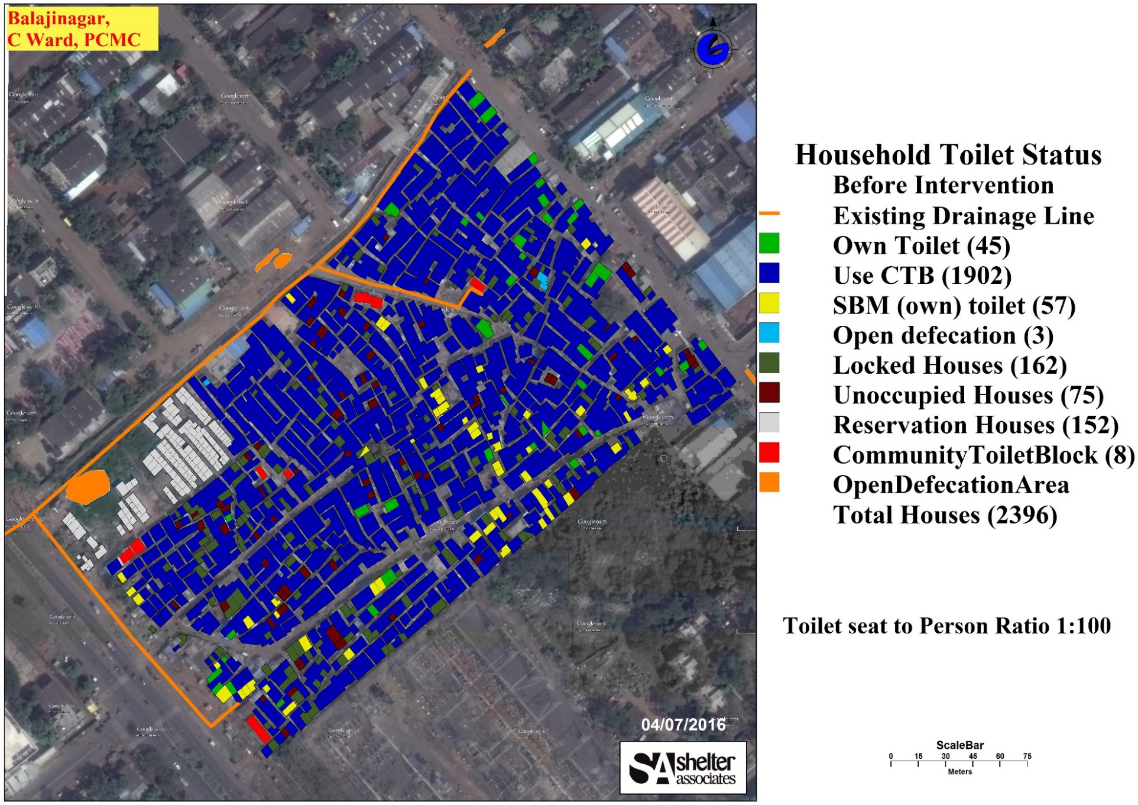
Capabilities – GIS mapping
Pre Intervention- HH having Individual toilets- 2.2%

Slide 60
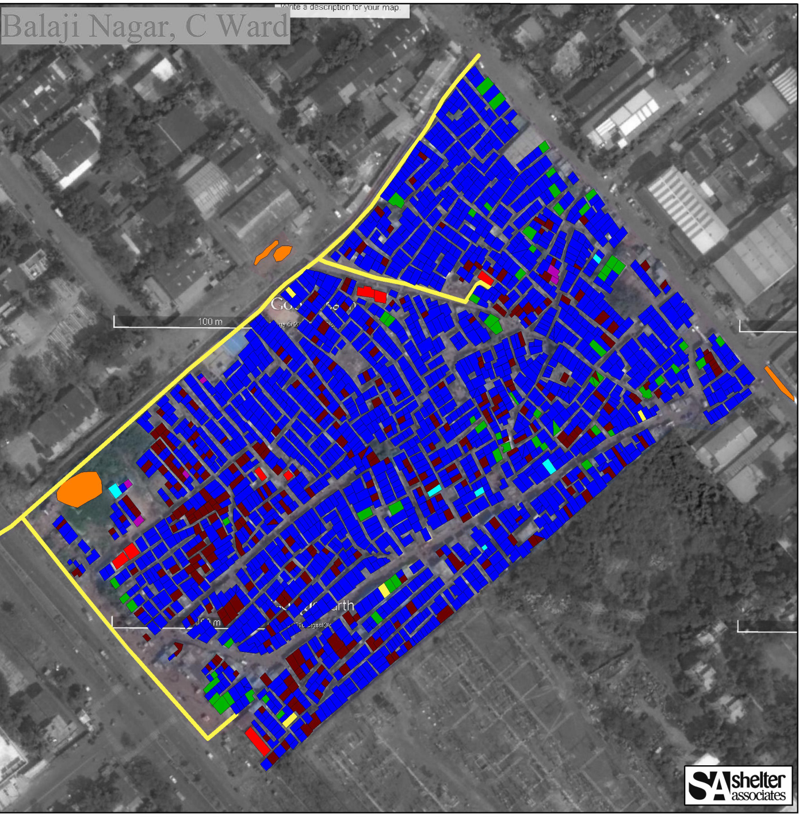
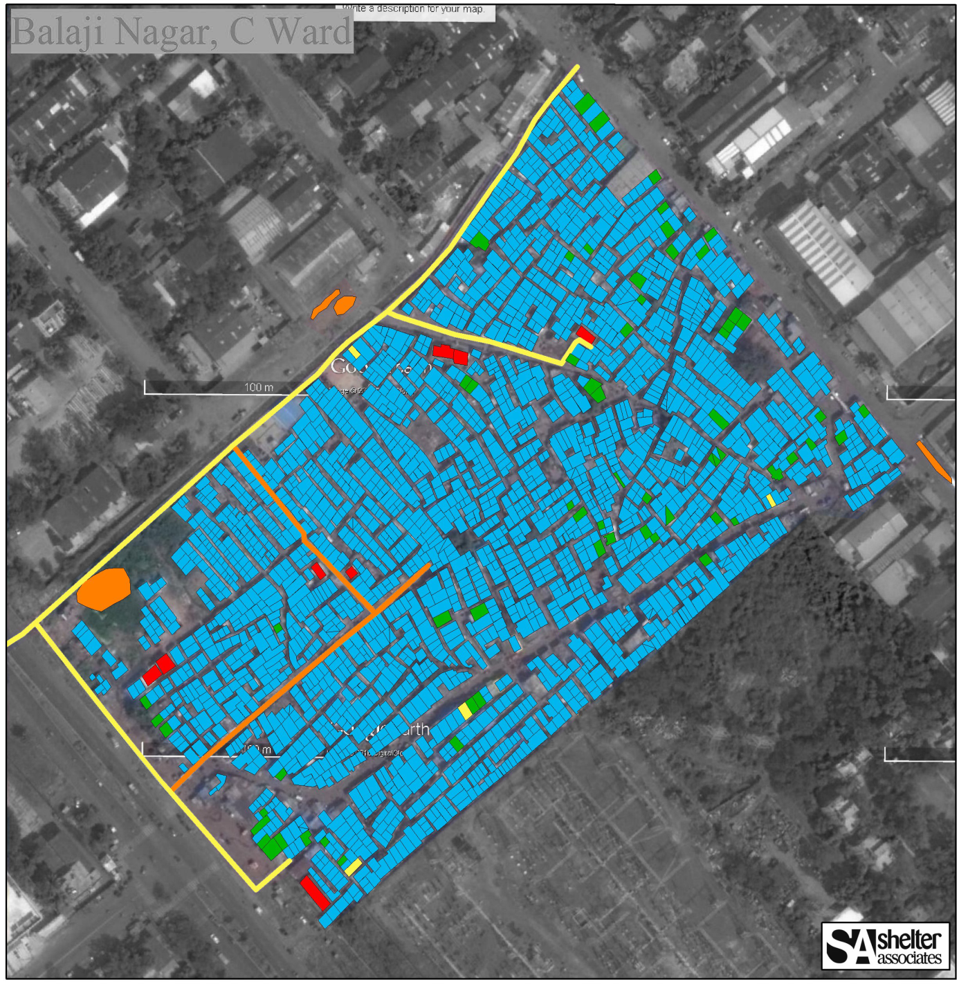
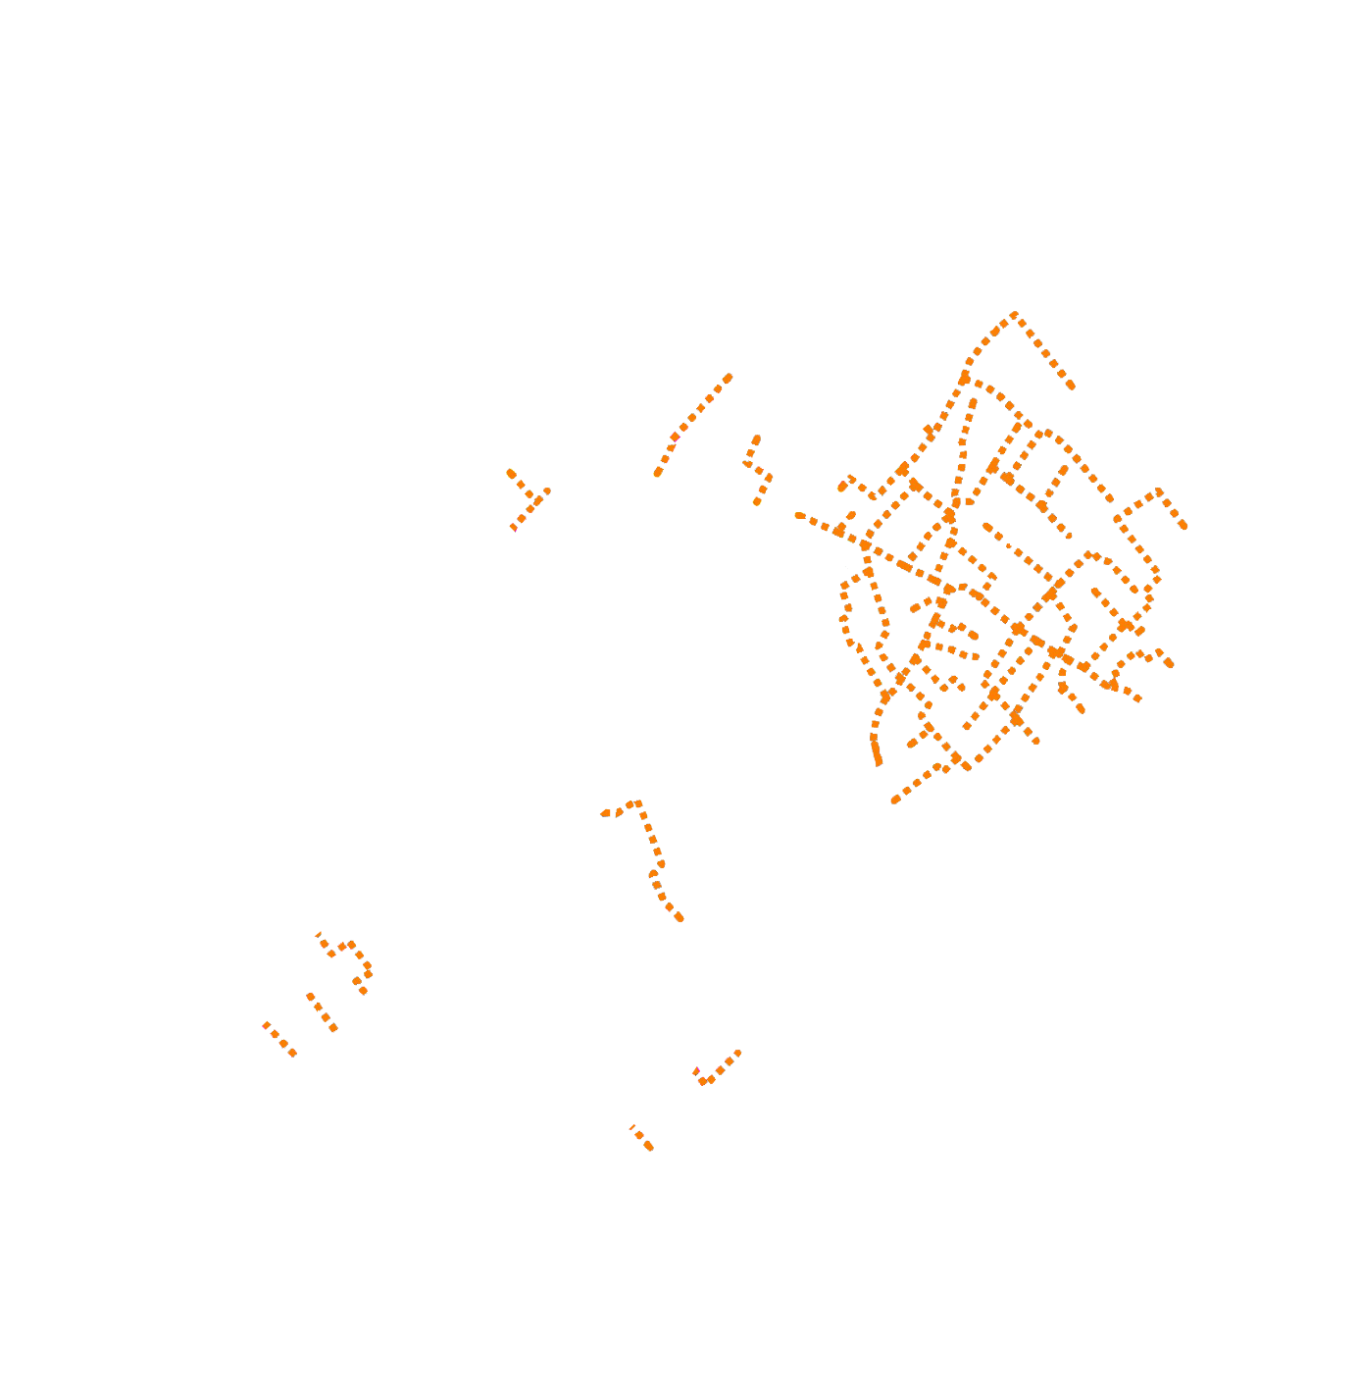
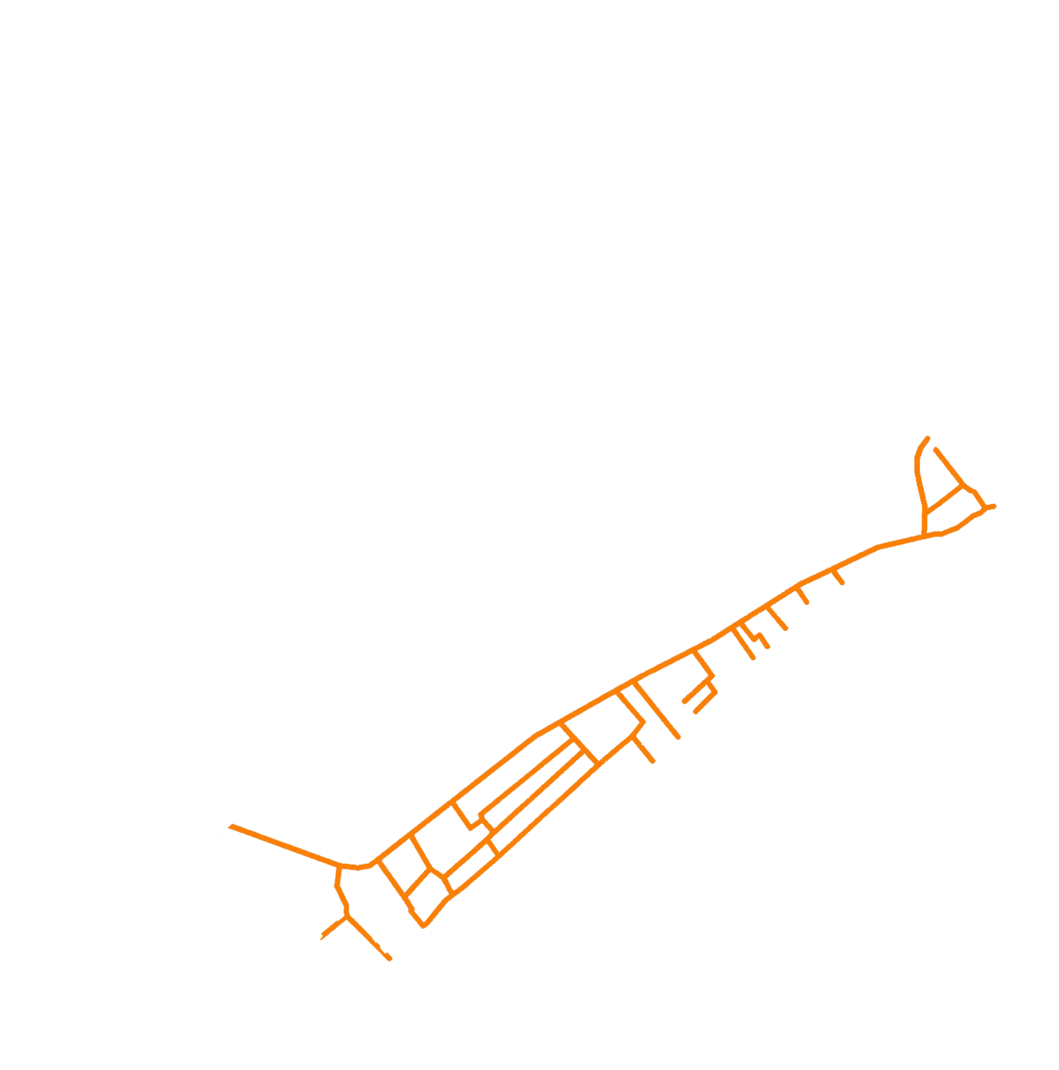
Capabilities – GIS mapping
Monitoring and Tracking The Process
Household toilets facilitated by SA
New drainage lines laid by PCMC
New drainage lines being laid by PCMC- work in progress as of today

Slide 61
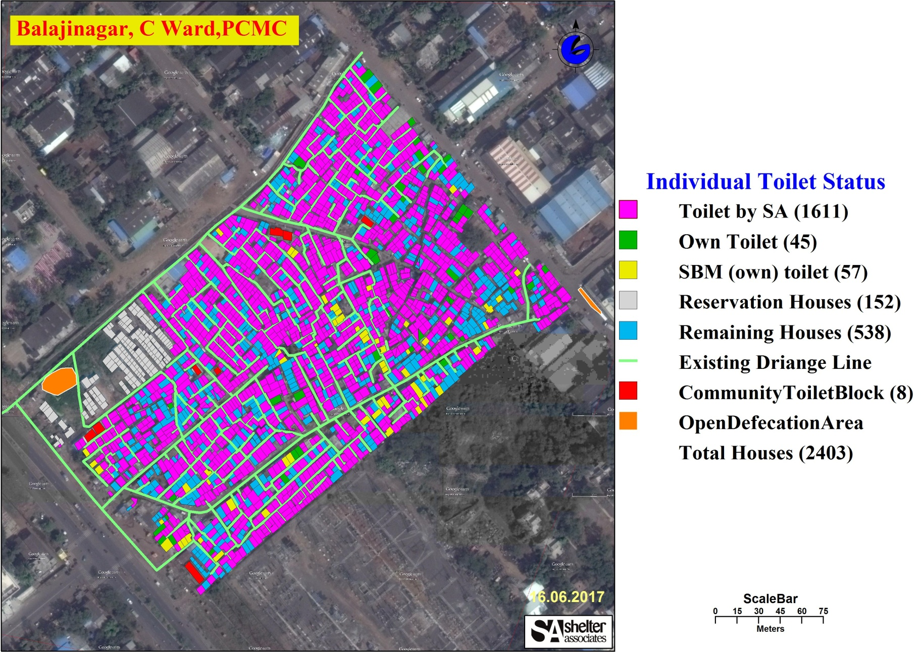
Capabilities – GIS mapping
Post Intervention-HH having Individual toilets- 77%
Community Toilet Block:
Toilet seat: person
ratio has been brought down from
1: 100
to
1: 31

Slide 62
Capabilities – Mobile App

Slide 63
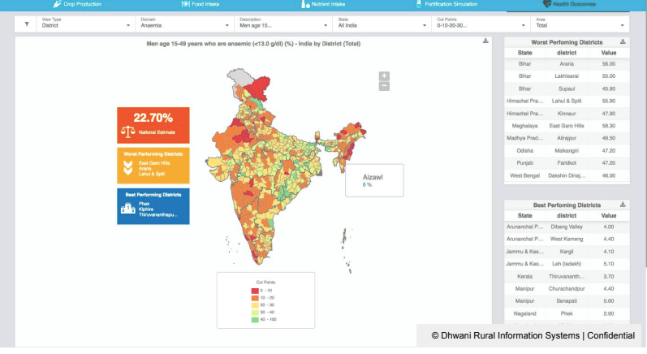
Capabilities - Dashboard

Slide 64
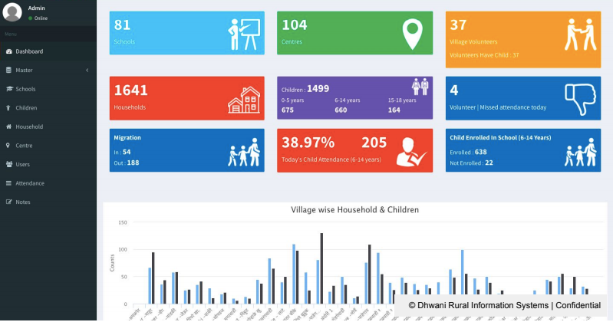
Capabilities - Dashboard

Slide 65
Conclusion
Empowered Rani
Aware Family
Healthy Community
Informed Donors
Proactive Policy Makers

Slide 66
Any Questions?

Slide 67
What Next?

Slide 68
Timeline
Demo Day
2 yrs
3 months

Slide 69
Targeting : 1 or 2 Location
Beneficieries: 1500+ (per loc)
Funding: $ 0.6 to $1m

Slide 70
Funding the System

Slide 71
Gaps and Other opportunities

Slide 72
Any Questions?

Slide 73
Hemang Shah & Biva Rajbhandari
Childrens Investment Fund Foundation

Slide 74
Thank You

